Slide 1


ADAPTATION OF DEEP NEURAL NETWORK FOR OPTIMIZATION OF STUDENTS REVISION CLASSES
PRESENTS
BY
ADEBAYO ADETAYO ABDULRASAKI
AND
IGWE PRECIOUS CHIAMAKA
SUPERVISOR IN-CHARGE:
Mrs. Mahmood Zinab
Notes:
1

Slide 2
INDEX
Introduction
Motivation
Problem Statement
Aims and Objectives
Literature Reviews
Research Methodology
Proposed Implementation
Result and Contribution to knowledge
Progress Report
Selected References

Slide 3
INTRODUCTION
Students often cram information right before tests, which is known as massed learning. However, this method is ineffective for long-term retention. (Ebbinghaus et al. 2021) demonstrated that crammed material is quickly forgotten if not regularly reviewed, illustrating this with the "forgetting curve

Slide 4
MOTIVATION AND PROBLEM STATEMENT
MOTIVATION
The rise of e-learning platforms has created a demand for personalized learning experiences that adapt to users' needs. An effective recommendation system can enhance these platforms by automatically selecting and timing content delivery based on user behavior. Brusilovsky, P., & Millán, E. (2021)
PROBLEM STATEMENT:
Current methods rely on manual criteria for content recommendations, which are less efficient. This work aims to improve upon existing models, like the one by (Reddy et al. 2021), by developing an end-to-end recommendation system. This system will learn criteria for content delivery autonomously using different reward functions on updated student states to evaluate efficiency.

Slide 5
AIMS AND OBJECTIVE
AIM To develop an end-to-end recommendation system for e-learning platforms that autonomously learns and optimizes content delivery for personalized learning experiences.
OBJECTIVES
Design and Implement an end-to-end recommendation system that replaces manual content selection with automated learning.
Explore and Evaluate different reward functions to improve the system’s effectiveness compared to existing models.
Analyze the efficiency of the new system in providing personalized learning recommendations based on user behavior data.

Slide 6
LITERATURE REVIEWS
E-LEARNING PERSONALIZATION
Personalization improves engagement and outcomes. Recommendation algorithms include collaborative filtering, content-based, and hybrid methods (Brusilovsky & Millán, 2023).
CRAMMING VS. SPACED REPETITION
Cramming is less effective for long-term retention compared to spaced repetition, which uses scheduled reviews to enhance memory (Ebbinghaus, 2021).
DEEP LEARNING IN RECOMMENDATIONS
Deep Neural Networks (DNNs) optimize educational content delivery by learning user behavior patterns (Hinton et al., 2023).

Slide 7
RESEARCH METHODOLOGY
Data Collection:
Gather sources of data e.g. (Past test score, Exams, Assignment records, etc)
Feature Engineering:
Extract meaningful features from the collected data.
Model Architecture:
Input Layer: The extracted data e.g. (Past test score, Exams, Assignment records, etc).
Hidden Layers: Learn complex patterns.
Output Layer: Generate future exam questions.
Train the DNN:
Use historical data to train the DNN for future purpose.

Slide 8
PROPOSED IMPLEMENTATION
* // Data Collection & Preprocessing (Offline)
FUNCTION collect_student_data():
student_data = [
{past_scores: [70, 85, 90],
];
RETURN student_data;
* // Data Collection & Preprocessing (Offline)
FUNCTION preprocess_student_data(data);
* // Define input model
FUNCTION define_model(input_size, hidden_layers, output_size);
// Train the model
FUNCTION train_model(model, training_data, validation_data, epochs);

Slide 9
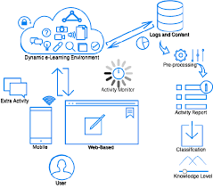
SYSTEM ARCHITECTURE

Slide 10
SYSTEM REQUIREMENTS
. Memory (RAM): Minimum 4 GB RAM
Storage (Hard Disk): Minimum 500 GB free space
CPU: Minimum 2 GHz multi-core processor
Network: Reliable internet connection with sufficient bandwidth.
SOFTWARE REQUIREMENTS
PYTHON
PANDAS
NUMPY
TRANSFLOW
KERAS
MATPLOTLIB

Slide 11
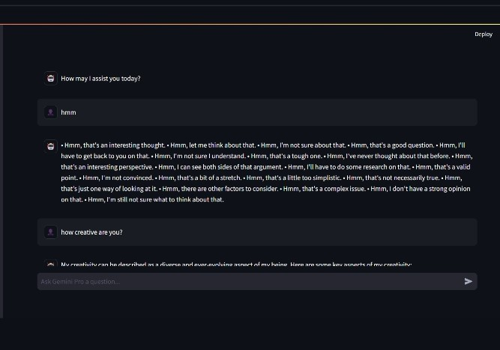
RESULTS

Slide 12
CONTRIBUTION TO KNOWLEDGE
Enhanced Personalization: Advances e-learning by automating content recommendations with a self-learning system.
Spaced Repetition Innovation: Introduces new reward functions for optimizing learning schedules.
Deep Learning Application: Applies DNNs to improve recommendation accuracy in education.
Improved Learning Outcomes: Aims to boost engagement and effectiveness through personalized content.

Slide 13
FUTURE WORK
ACHIEVEMENTS:
- Design: Completed Software and DNN setup.
- Data: User data collection in place.
- Training: Initial model training done.
STATUS:
- Testing: Evaluating with user data.
- Interface: Integrated with the platform.
Next Steps:
- Refine: Improve algorithms and reward functions.
- Deploy: Full system rollout and monitoring.

Slide 14
CONCLUSION
In summary, using deep neural networks (DNNS) deep neural network for optimization of students revision classes before exams empowers personalized learning, early intervention, and data-driven decision-making in education to enhance student experience. Hinton, G. E., Osindero, S., & Teh, Y. W. (2023)
NB: It's important to note that the specific results will vary depending on student's goals and the features of the DNNs

Slide 15
SELECTED REFERENCE
Brusilovsky, P., & Millán, E. (2021). User Models for Adaptive Hypermedia. In The Adaptive Web (pp. 3-53). Springer. https://doi.org/10.1007/978-3-540-72079-9_1
Ebbinghaus, H. (2021). Memory: A Contribution to Experimental Psychology. Annals of Neurosciences, 28(2), 70-95. https://doi.org/10.1159/000514084
Hinton, G. E., Osindero, S., & Teh, Y. W. (2023). A Fast Learning Algorithm for Deep Belief Nets. Neural Computation, 18(7), 1527-1554. https://doi.org/10.1162/neco.2006.18.7.1527
Mnih, V., Silver, D., & Sutton, R. S. (2015). Human-level Control through Deep Reinforcement Learning. Nature, 518(7540), 529-533. https://doi.org/10.1038/nature14236
Ricci, F., Rokach, L., & Shapira, B. (2011). Recommender Systems: Challenges and Research Opportunities. In Recommender Systems Handbook (pp. 1-35). Springer. https://doi.org/10.1007/978-1-4419-1173-6_1
Reddy, S. M., Boudreaux, E. D., & Siracuse, J. J. (2021). Model-Free Review Scheduling in Spaced Re

Slide 16


